Slide 1
Good Bean Mockup
The Dolphins
-Ebru Dagdelen
-Brian Ries
-Nic McGrogan

Slide 2
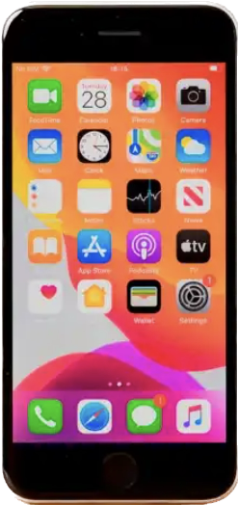


Good Bean
Good Coffee • Good people • Good Place
loading…

Slide 3
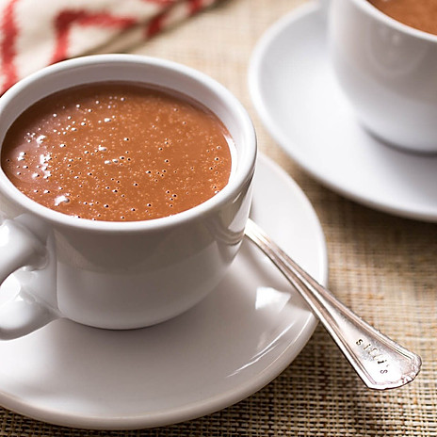
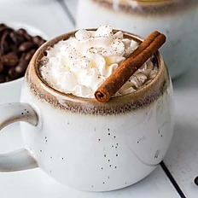
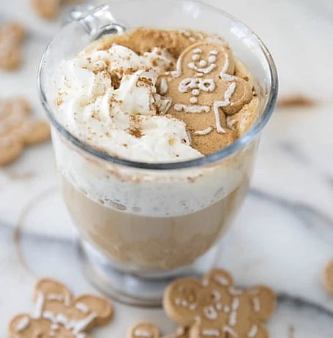





Welcome!
Try our winter populars:
Organic Hot
Chocolate
Snickerdoodle Latte
Gingerbread Latte
Brewed Coffee
Espresso Classics
Iced/Frozen Drinks
Specials
Non Coffee
Click
Smoothies

Slide 4
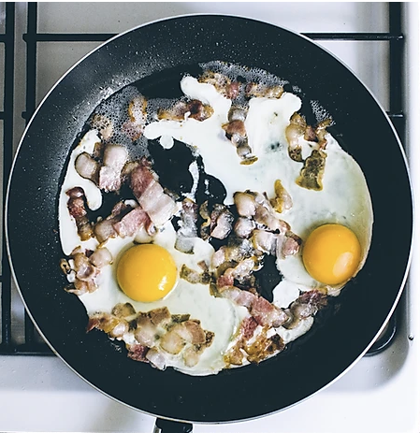
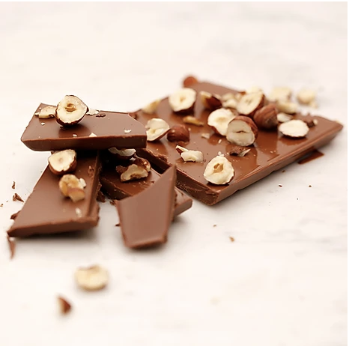
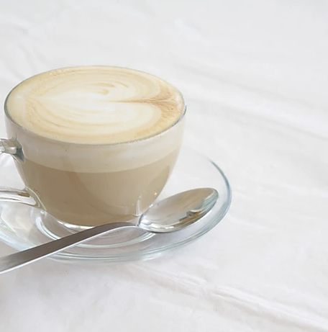
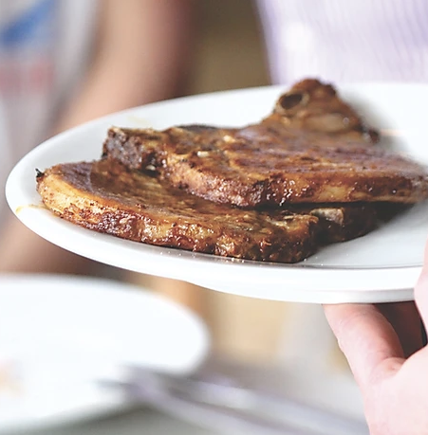
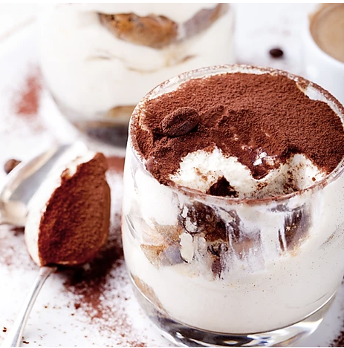
Specials:
Breakfast in Bed Latte
Scroll
Up
And
Down
Chocolate Nut Latte
Tiramisu Mocha Latte
Lavender Vanilla Latte
Click
Cinnamon French Toast Latte

Slide 5
Lavender Vanilla Latte
Lavender and Vanilla flavors, espresso, steamed milk
Scroll down once desired size is picked
Pick size:
Regular $4.75
Click
Large $5.74
Extras:
Espresso Shot $1
Flavor Shot $0.50
Almond, Soy, $0.50
Coconut or Oat Milk

Slide 6
Lavender Vanilla Latte
Lavender and Vanilla flavors, espresso, steamed milk
Quantity:
1 - +
Pick up time:
<Current date will be displayed>
9 : 30 AM
Continue to checkout…
Click

Slide 7
Payment:
o Debit/Credit:
Number: ___ ___ ____
Security Code: ___
Name on Card: _____________
o Apple Pay
o Paypal
o Google Pay
o Gift Card
Initial Cost: $4.74
Extras: $0
Points Used: - $0.50 (25 points)
Tax: $0.30
—------------------------------------------------------
Total: $4.54
Email for confirmation: ________
Want to get text messages when order is ready?
Enter phone number: +1 ___ ___ ____
Order
Click

Slide 8


Thank you for your purchase! An order confirmation has been sent to cus******@hotmail.com.
After the confirmation, the screen will return to the main menu screen.

Slide 9
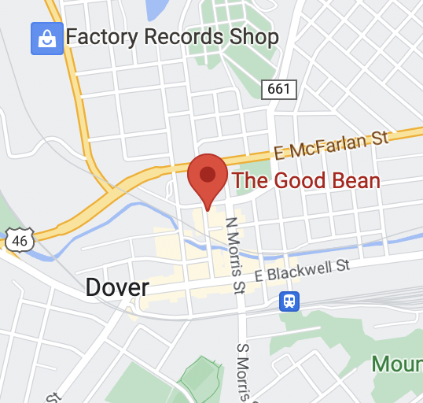
Locations:
Address: 60b N Sussex St, Dover, NJ 07801
Deals at this location: Extra 5 points for every order!
Store Hours:
Monday-Friday - 6:30 AM - 6:30 PM
Saturday - 7:30 AM - 5 PM
Sunday - 8 AM - 1 PM
Navigate
Click

Slide 10

Receipts:
March
Order #321 $5.71
3/2/2023 +11 points
Dover location
View Details
Scroll
Up
And
Down
Order #987 $6.00
3/1/2023 +12 points
Dover location
View Details
February
Order #432 $13.29
2/24/2023 +26 points
Dover location
View Details
January
Order #738 $4.20
1/19/2023 +8 points
Dover location
View Details
Order #029 $4.96
1/19/2023 +9 points
Dover location
View Details
Click
Order #029 $5.63
1/19/2023 +11 points
Dover location

Slide 11
Order #029
Order Date & Time:
1/19/2023 - 12:53 PM
Location:
60b N Sussex St, Dover, NJ 07801
Payment Method:
Gift Card…2080
Order Items:
1 Lavender Vanilla Latte $4.75
Sub-Total: $4.75
Tax: $0.21
Total: $4.96
Points Earned For This Order:
Base Points: 9
Location Promotion: 5
—-----------------------------------------
Total Points: 14

Slide 12
Favorites:
Tiramisu Mocha Latte
Large
With Soy milk
remove
Looks a bit empty here, why don’t you try some of our popular items listed on the top of our menu!
Good Bean
Good Coffee • Good people • Good Place

Slide 13
My Account:
15 30 45 60 75 90
Keep earning for a free drink!
Claim reward
*25 points for a free extra!
*75 points for a regular sized drink!
*100 points for a large sized drink!
Name:
Liza Smith
update
Email:
cu*******@hotmail.com
update
Phone number(optional):
+1 ___ ____ ____
update
Payment Information:
Visa ***4978
update
Log-Out Delete Account
Good Coffee • Good people • Good Place
created with love 🤍

